Slide 1
Soccer Games Analysis
Abdellah Afellah

Slide 2
Hypothesis:
I have been playing soccer since I was 3 year old. Through my childhood to present, I tried to play consistently. I’ve been known for my powerful left shots and good control of the ball. I always felt I had a good impact in my games. Let’s put it on test!
I played last winter in two indoor soccer leagues. Each league consistent 8 games.
Question: Is my contribution to the games is significantly made a difference to win them?
Null hypothesis: mu(win) = mu(loss)
Alternative hypothesis: mu(win)!=mu(loss)

Slide 3


Data Collected
Games | Goals | Assist | Results
1 | 2 | 0 | Tie
2 | 3 | 1 | Win
3 | 1 | 2 | Tie
4 | 0 | 1 | Loss
5 | 4 | 0 | Tie
6 | NA | NA | NA
7 | 3 | 0 | Win
8 | 2 | 0 | Win
9 | 1 | 1 | Loss
10 | NA | NA | NA
11 | 4 | 0 | Win
12 | 2 | 0 | Win
13 | 3 | 1 | Win
14 | 3 | 0 | Win
15 | 1 | 1 | Tie
16 | 3 | 1 | Win

Slide 4
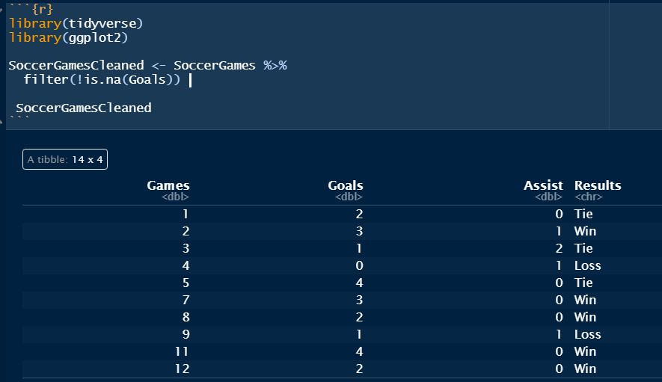
Data Wrangling: Filter the data from no value

Slide 5
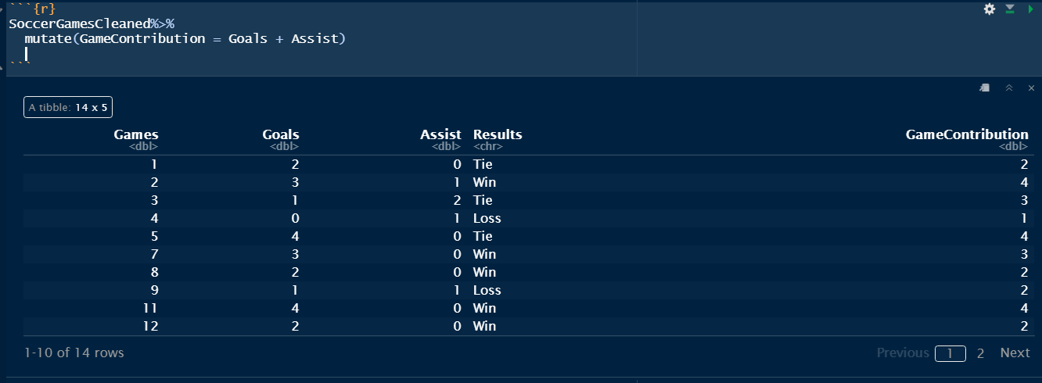
Data Wrangling: Adding new column “GameContribution” since assisting to score is very important as Scoring goals. Note: Assist in soccer is counted when you are the last the player to pass the ball to scoring player.

Slide 6
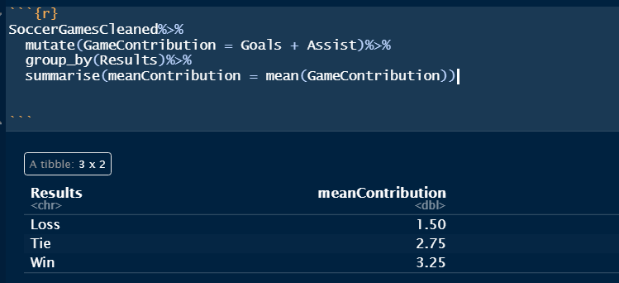
Graphing data: First we grouped the results and calculate its mean of contribution

Slide 7
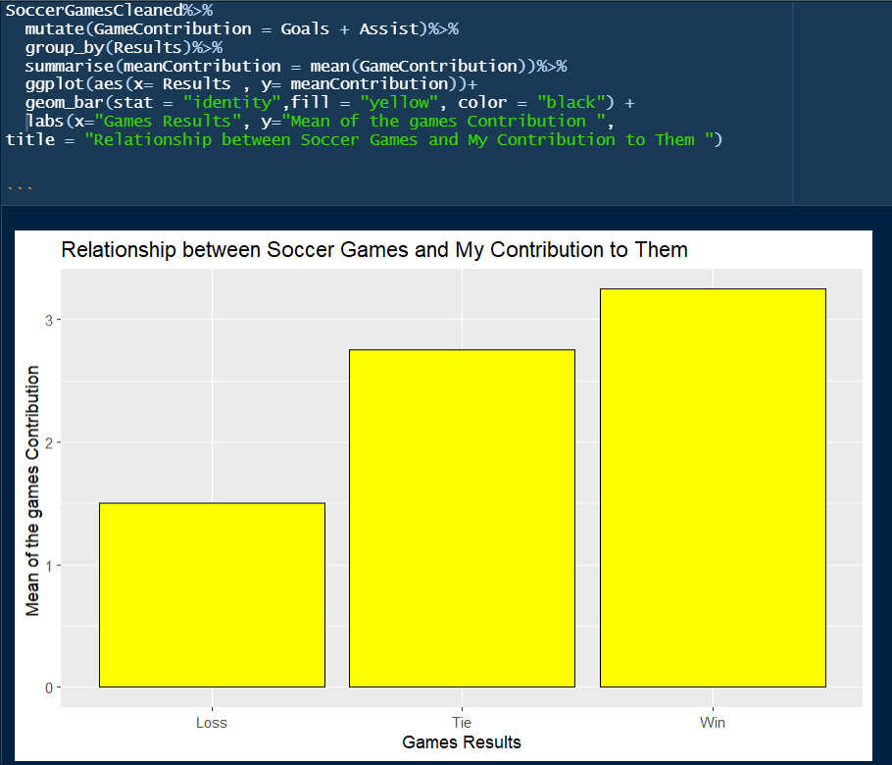
Graphing data: Now we establish the graph of results relatively to my contribution

Slide 8
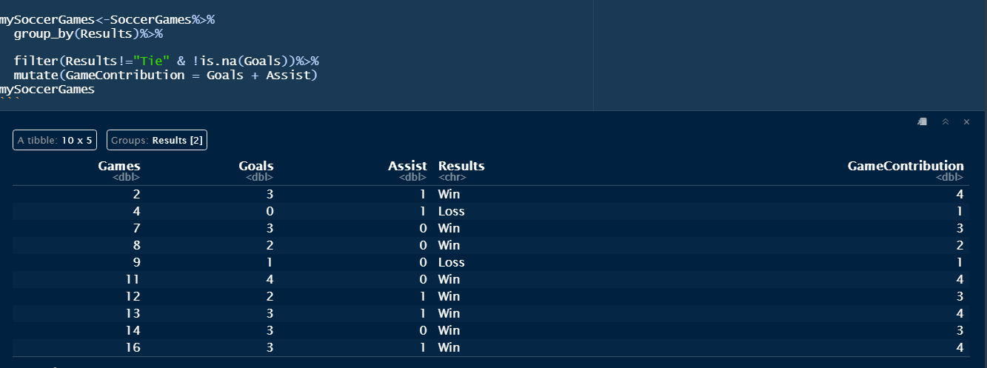
T-test Analysis: Null hypothesis: H0: mu(win) = mu(loss) Alternative hypothesis: Ha: mu(win) != mu(loss) we‘re going to ignore „Tie“ results.

Slide 9
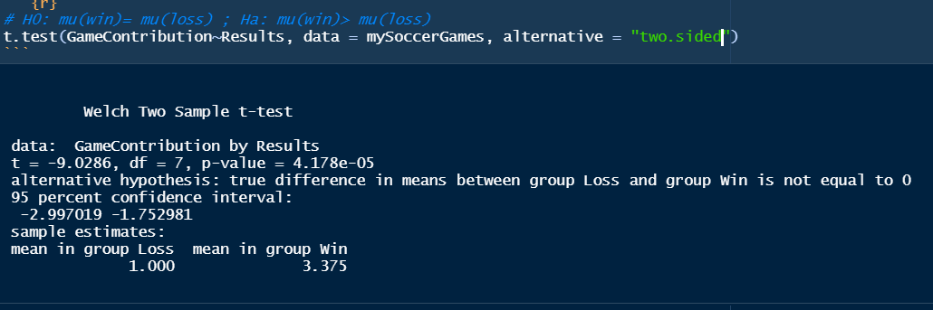

T-test Analysis

Slide 10
Conclusion
Since p-value is very low , we can reject the null hypothesis H0.
Therefore, there is evidence to support the claim that my contribution to the games is significantly made a difference to win them.

Slide 11



Slide 12



